Slide 1



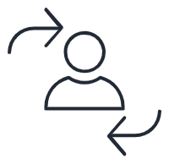

PhoneNow
Click on the icons to drill down
KPIs
Churn Dashboard
Customer Risk Analysis
Notes:
Overview Page (Welcome Page)

Slide 2






This dashboard has a filter with churn = "yes"
Notes:
Churn Page

Slide 3
Notes:
Customer Risk Analysis Page

